Slide 1
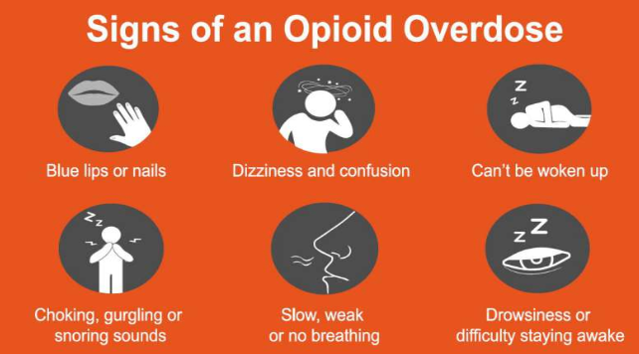
Opioid Prescription Prediction Model
Data exploration/analytics/classification model selection summary/use cases
Notebook model reference (please access the code at this location): https://nbviewer.jupyter.org/github/DataScienceKam/health_care_mdoel/blob/master/Opioid_Overdose.ipynb?flush_cache=true

Slide 2

Prescription Opioid Overdose Prescription Prediction (Drug Abuse & Use)
Understanding product and client
Hypothesis Formulation
Data Sources
Data analytics/exploration results
Data massaging/ reformatting to fit classification models
Experimenting with Classification models
Spin off/extrapolating the model to other opportunity and use cases in the health care industry and limitations
Reference:
Data Science Best practice
https://kepler.bjss.com/display/DATA/Data+Science+Industrialization

Slide 3
Understanding product and client
The model has high ramifications in the following areas:
1
Government agencies associated with the health sector- Medicare, Medicaid, Federal and State Regulatory Agencies including DEA (Drug Enforcement Administration), Tobacco Drugs and Firearms, US Customs & Border Control who can track patients with high risk conditions. This model is also useful for the Narcotics division (NDDS) which will help them identify prescription drug dealers by reviewing the patient list of the opioid prescribing doctor
2
Pharmaceuticals and drug dispensing agencies who have records of the total number of opioid prescriptions per patients and the opioid prescriber list and can pick out exceeding dosages and caution the patient/doctor in a timely manner.
3
Medical Insurance companies that cover pharmacy claims especially from the ”Part D Drug Formulary List”. This predictive model is of great value to this industry since it can effectively reduce the substantial cost incurred due to the aftermath of opioid overdose such as hospitalization and emergency care and following law suits
4
Doctors (affiliated to hospitals or private practitioners) would also benefit from this model. As a doctor it is hard to keep tab of all the drugs that have been dispensed under their badge. If there is a risk of high end opioid prescription, pharmacists and medical insurance agencies can caution the doctor about the exceeding opioid prescribing rate thereby controlling the distribution of opioids which would reduce fatality rate on a grand scale
5
Public Health sectors involved in counseling services and protecting and improving the health of people and their communities. Statistics shows that opioid abusers are also prone to depression with higher suicidal rates. This model will help reduce mortality rates related to opioid overdose
Patients with access to the database will have a chance to alter their drug abusive behavior- cautioning patients of an impending death related to high dosage of opioid and counseling them of the ramifications of impact of other substances such as alcohol and opioid interaction will not only reduce mortality rates but it will also decrease the substantial cost of hospitalization
6

Slide 4
Hypothesis formulation
Source: https://www.ncbi.nlm.nih.gov/pmc/articles/PMC5741109/
“The United States is the world's largest consumer of opioids, and as prescriptions increased from 76 million in 1991 to 219 million in 2011, there were corresponding increases in opioid-related emergency room visits, treatment admissions, and overdose fatalities. An estimated 25 million people initiated nonmedical use of pain relievers between 2002 and 2011, and by 2014, 10.3 million Americans were reporting the nonmedical use of prescription opioids. The Centers for Disease Control and Prevention (CDC) estimated that over 60,000 drug overdose deaths occurred in 2016, with overdose death rates three times the rate of 1999.”
Hypothesis :
Identifying opioid prescription behavior based on non-opioid prescription trends ( the lists comprises of drugs typically used for the treatment of chronic or acute conditions associated with pain symptoms such as body aches, heart burn, arthritis or HIV to name a few), state, gender, and specialty of the prescribing physician
Total of 240 non-opioid drug prescriptions are included in the dataset. Some of these are:
ACYCLOVIR: Used for herpes virus infections or excruciatingly painful conditions such as shingles and also used by HIV patients for the treatment of various infections
DIAZEPAM: Subdues anxiety, muscle spasms, and seizures- typically characterized by painful aftermath
LAMOTRIGINE: Bipolar disorder- (studies indicate that these patients are typically prone to depression and tend to abuse drugs over time)-
reference: https://www.addictioncenter.com/addiction/bipolar-disorder/
IBUPROFEN: Used to quell severe pain and is a very strong form of drug associated with kidney failure with chronic usage
FAMOTIDINE: Used for the treatment of ulcers, gastroesophageal reflux disease, or heart burn pains
LIDOCAINE: Relieves pain and numbs skin (analgesic)

Slide 5
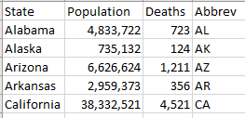
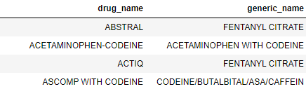

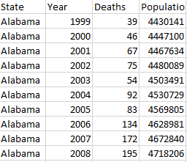
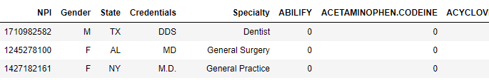
Data Sources
Overdose data sources
Opioid dataset
Prescription details
Final data size after filtering columns and rows – 24,759 rows and 254 columns
2
Identifies the Opioid drugs in the prescription dataset
3
The primary dataset used to predict physicians who are prone to dispensing generous amounts of opioids. Caution must be observed in sticking labels as the physicians might not be aware of number of prescriptions dispensed and might be exhibiting compassion to the patient
1
Comprises of data related to prescription drug overdose mortality rates with population figures

Slide 6
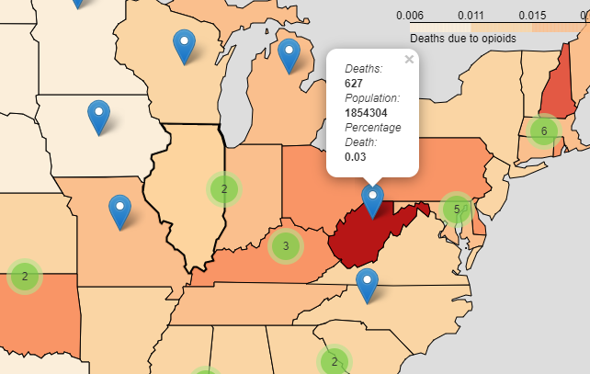
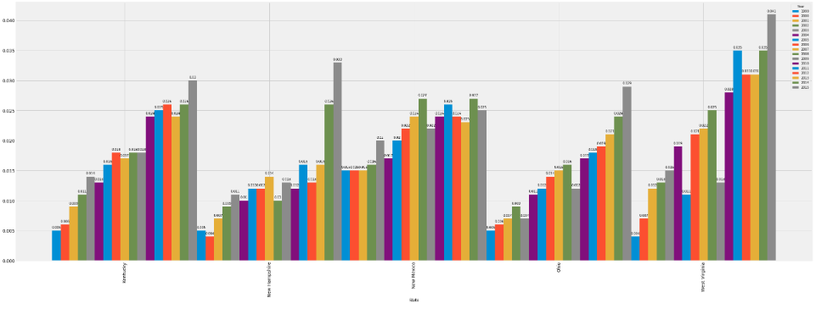
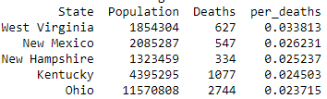
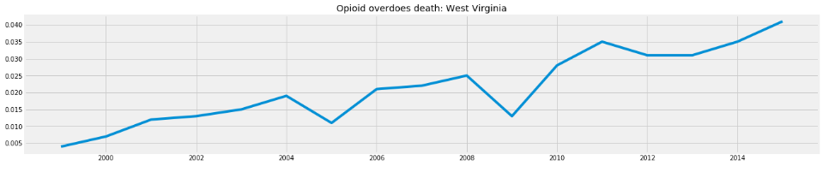
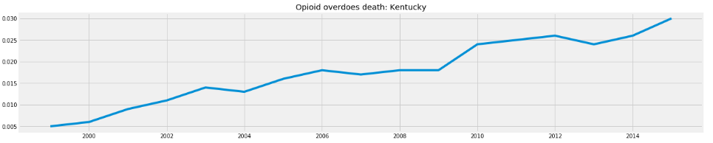
Data analytics/exploration- Overdose mortality trends
1
Top 5 states based on population
2
Mortality graph exhibits continuous increase in fatality rates from 1999- 2015 attributed to prescription based opioid overdose
3
Future trend analysis and projections were inconclusive due to small data size but projection graphs exhibit a small growth rate in mortality rates- the model needs more granularity for accurate figures- extraneous factor (govt intervention) will alter projection rates
Inference: Model trend seems to indicate that federal mandates are not uniform across all states- however data is only from 1999-2015

Slide 7
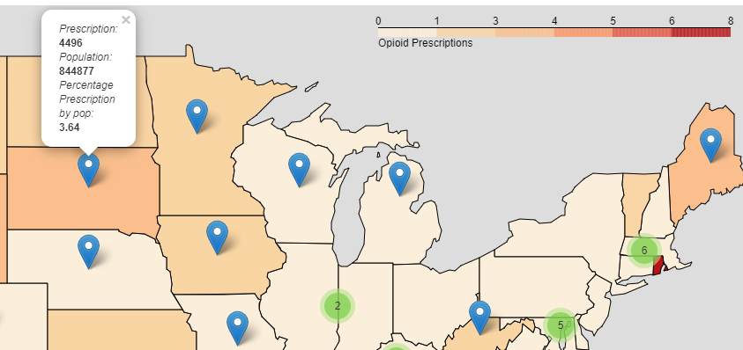
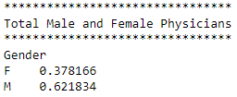
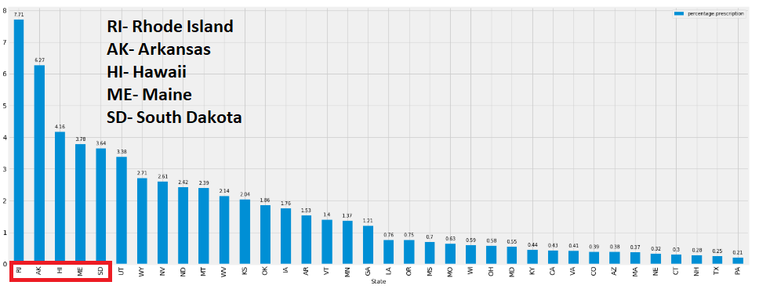
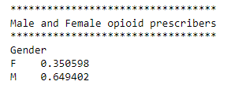
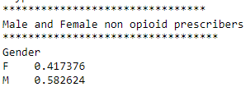
Data analytics/exploration- Prescription data - 1
1
Top 5 opioid prescription states based on population is displayed in the bar graph
2
Gender classification: In the dataset women tend to prescribe more opioids in particular states, but overall they were fewer women physicians prescribing opioids

Slide 8
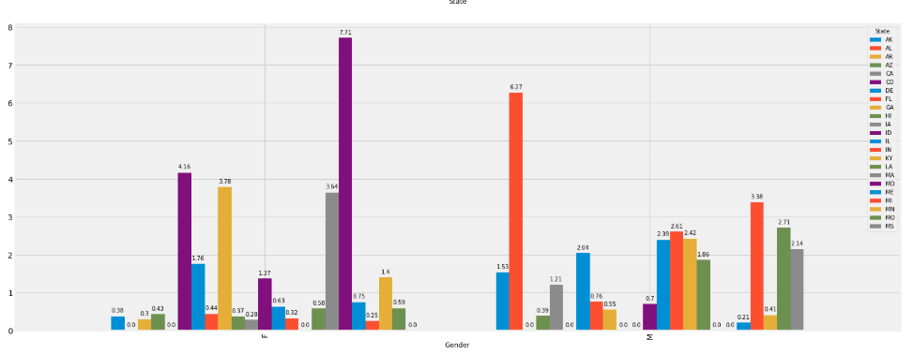
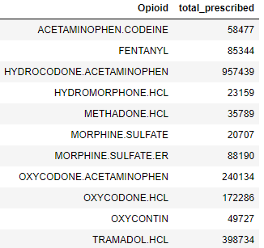
Data analytics/exploration- Prescription data - 2
Percentage prescription of prescription opioids based on population grouped by Gender and State
1
The most number of opioid prescriptions were from Maryland with Female physicians prescribing more opioids overall when the data was grouped by Gender and State. This could be attributed to compassion
2
Alabama topped the list for Male physicians when the data was grouped by Gender and State
Total number of opioid prescribed for the year 2014: HYDROCODONE tops the list as the most prescribed drug followed by TRAMADOL
3
Trivia: Hydrocodone is used to treat moderate to severe pain due to chronic condition, injury, or surgery. It should only be taken as prescribed by the doctor because of the risk of addiction. Because of the way it’s prescribed, hydrocodone appears more likely to be prescribed compared to other opioids. It’s misused more than any other opioid in the United States. The drug is already banned in European nations due to its abusive tendencies. (healthline.com)

Slide 9
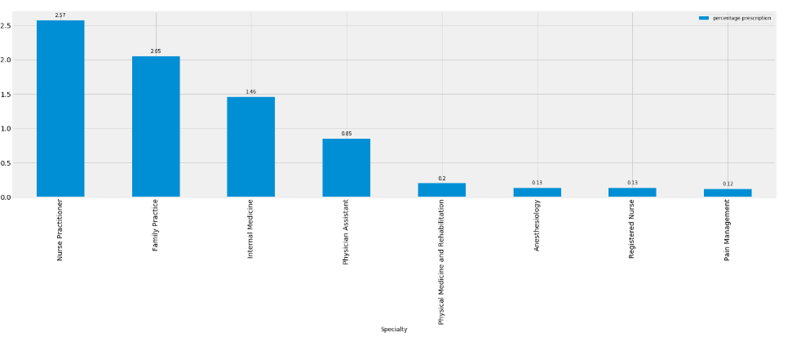
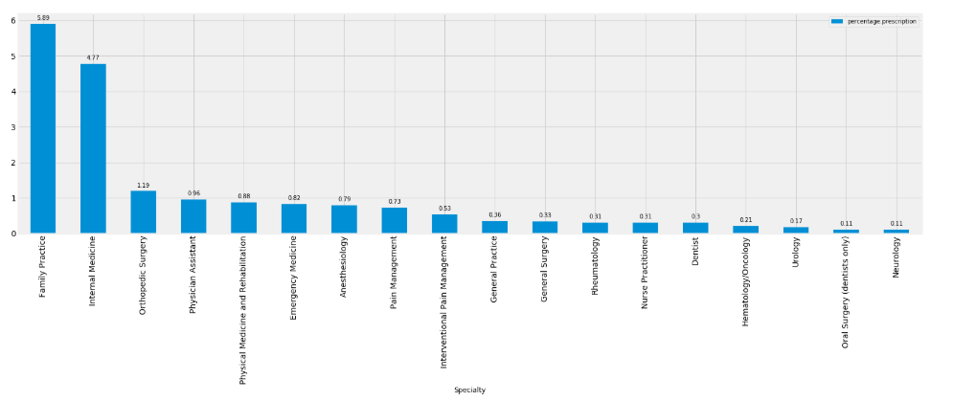
Data analytics/exploration- Prescription data - 3
Percentage prescription of opioids based on population grouped by Gender and Specialty
Nurse Practitioners, Family Practice, and Internal Medicine tend to prescribe more opioids compared to other specialties in the female category (these specialties tend to treat patients from diverse background with both acute and chronic conditions- in essence we do not have corresponding patient data to see why this glaring trend was noticed).
2
Family Practice, Internal medicine, and Orthopedic surgery tend to prescribe more opioids compared to other specialties in the male category. The top 2 specialty tends to see patients from diverse backgrounds, however orthopedic surgeons have patients with chronic pain conditions. We do not have corresponding patient data to see why this glaring trend was noticed
1

Slide 10
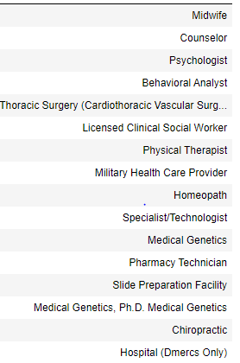
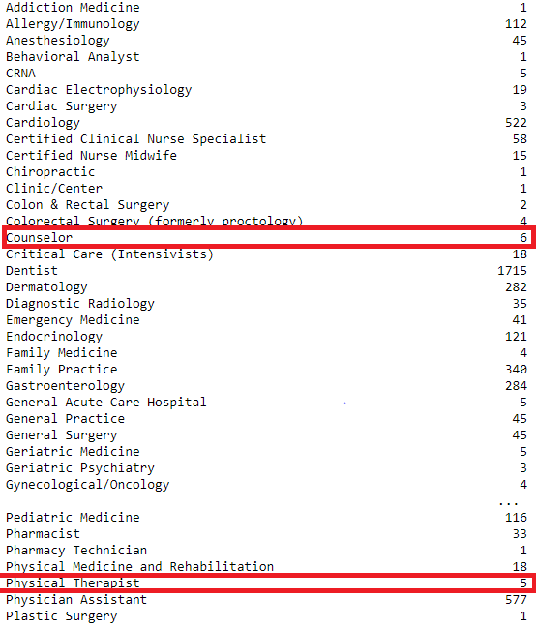
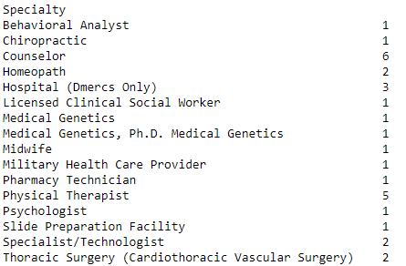
Non Opioid prescribers (where target column value = 0 in all instance)
2
But there is a gross mismatch in the representation of the population based on specialty If you notice there are more Gastroenterology and Dentist in the population versus Midwife or Chiropractic. Perhaps there are other factors contributing towards these population numbers but this study is beyond the scope of this project. Nevertheless we cannot deduce with absolute certainty that they are not high end opioid prescribers- in real world situation it is perhaps better to drop these columns or group then under other category
1
Specialties which are not in the high end opioid prescribers list. In the dataset all of these specialties have the target column or predictive column marked as 0

Slide 11
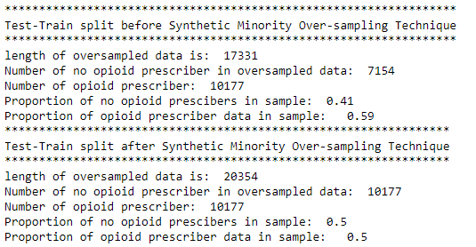
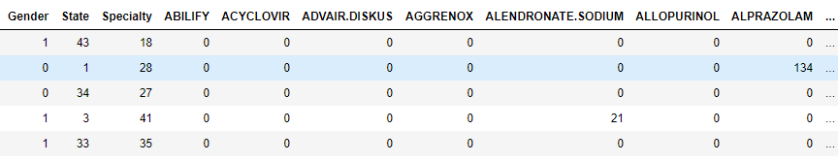

Data Massaging and reformatting to fit model
Selected and reject columns/rows and test-train split:
The following columns were included in the analysis Gender > State > Specialty > Non Opioid drugs associated with pain or chronic/acute illness associated with pain Excluded columns: NPI # > Credentials > Opioid Drug list
Excluded Rows: 'PR', 'AE', 'ZZ', 'GU', 'AA', 'VI' Note: Opioid drug columns produced abnormally high accuracy rates perhaps due to data leak?? Domain expertise is required to confirm- I have rejected these columns for analysis
SMOTE on the target column to ensure that there is a 50:50 split between non opioid and opioid drug prescribers (target variable).
Data Factorization to convert string to numeric values
Test- Train split on the target column => 30%: 70%
The data set did not comprise of many NULLs- while reading a 0 was included for the NAs and strings were converted to Integers for calculation fields such as Population
1
2
3
4
5

Slide 12



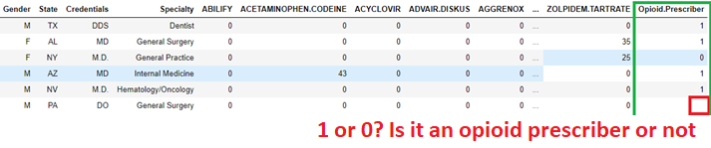
Experimenting with classification models
The following models were used for predictions:
Logistic Regression
Random Forest Classifier
Decision Tree Classifier
Naïve Bayes
Gradient Boosting
KNN
Linear Discriminant
Bagging Classifier
Stochastic Gradient Descent Classifier
Performance:
1
3 algorithms are suggested for this model to predict future outcomes based on the accuracy and precision and recall scores
Random Forest
Gradient Boosting
Bagging Classifier
2
These are the algorithms that I would recommend based on the dataset for predicting the target value
Details: https://github.com/DataScienceKam/health_care_mdoel/blob/master/Classification%20Model%20Recommendation.docx

Slide 13
Other opportunities with similar approaches (drug abuse & drug use)
Although the model primarily focuses on opioid prescribing behavior (abuse) this model can be applicable for tracking drug usage as well
1
Drug monitoring for use and abuse: If the model is extrapolated to drug warning systems where pertinent medications have not been picked up on a timely basis (e.g., seizure drug for epilepsy, insulin for diabetes, anti platelet drugs in patients with recent coronary stunt and HIV medication where it is mandatory for the patients to pick up timely medications on an ongoing basis), this model can prevent the onset of critical care and hospitalization
2
Drug compliance is a major issue in the medical industry and a cure is yet to be found. As medical insurance companies, pharmacies, and doctors struggle to align cure for critical and chronic diagnosis with drug usage, patients do not pick up life saving prescriptions on time and tend to skip pertinent dosage which causes a substantial financial loss leading to unnecessary hospitalization, unwanted emergency care, or even death. To complicate matters doctors are consistently sued for not warning patients to pick up these life saving prescriptions on time. A model that would predict patients who are prone to not picking up drugs on a timely basis based on age, gender, medical conditions and other important variables will be useful in sending out frequent reminders before tragedy strikes.
Limitations
3
Free flow of information is necessary for this process to work without hiccups. If small insurance companies do not want to share data, it can hurt their programs. An outreach program is required from sales ensuring indirect access to data by contacting hospitals directly for frequent "offenders"- patients who show up on regular basis for not refilling drugs and to warn them on a regular basis. In the end it is the doctors and the hospitals who have to endure medical litigations associated with patient/family member negligence. From this perspective I believe that hospitals will be more than willing to share patient prescription data even if medical insurance companies want to protect their data.

Slide 14

Sources
Primary Data Source
Secondary Data source
Pertinent articles in this subject matter
Data Analytics Report
Test/Tune/model validation report
Jupyter notebook
Notes:
In Slide Show mode, select the arrows to visit links.

